Slide 1
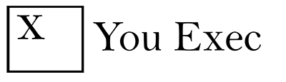
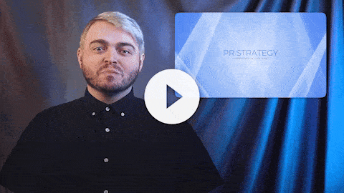
You Exec provides business resources that move your career forward. Access our full library of presentations, spreadsheet models, and business book summaries. We do the work, you take the credit.
Errors & Omissions Liability (E&O): You Exec makes no guarantee that the statements, analysis, projections, estimates, graphs, reports, numbers, and any derivatives sourced from this presentation are free of errors and omissions. You Exec assumes no liability for erroneous outcomes derived from this presentation.
Watch explainer
This video will walk you through the benefits of this framework. Paid members, please log in for a better viewing experience.
Found an error, have suggestions?
Feedback

Slide 2
PR STRATEGY
Presented by You Exec

Slide 3

BRAND VOICE SCALE
Formal/Professional
Informal/Casual
Classic
Modern
Authoritative/No Fluff
Friendly/Sincere
Abstract
Literal
Persuasive
Instructional/Analytical
Closing Oriented
Consultative
Relationships
Transactions
Economical
Premium/Luxurious
Humorous
Serious
Service Oriented
Low Price

Slide 4
MESSAGE MAPPING
INTERESTING, INEFFECTIVE
BEST MESSAGES
High
Ease of Use
Reliability
Convenience
Resonance
Bubble Size = Credibility
Responsiveness
Diligence
Assurance
Low
CUTS
EFFECTIVE. NOT INTERESTING
Low
Effectiveness
High

Slide 5
MESSAGE MAPPING TABLE
EFFECTIVENESS
CREDIBILITY
RESONANCE
Memorable
Aligned w/ Strategy
Consistent w/ Positioning
Objective
Believable
Not Fluffy
Trendy
Impact
Relevant
Weight
15%
10%
10%
10%
20%
5%
5%
15%
10%
Reliability
5
8
6
7
7
10
10
8
9
Assurance
10
8
6
6
5
4
3
2
5
Convenience
9
6
5
10
4
7
9
7
7
Ease of Use
7
8
9
2
4
4
7
10
9
Responsiveness
2
3
3
6
5
3
5
6
2

Slide 6
STORY FINDER
COMPANY STRUCTURE
TEAM
DAILY OPERATIONS
VALUE PROPOSITION
CUSTOMERSS
Who are your partners? What makes them interesting or unique?
Is your business model an innovation for your sector?
Have you raised a huge amount of investment or conversely got going on a shoestring?
Financing, Partners, Model
What’s your founder story? What obstacles did you overcome to get this business off the ground?
What did you do before your startup?
Who are your personal connections? Know anyone famous, relevant to your business?
Founders & Stuff
How do you make your product or deliver your service? Is there news in that?
Is your startup part of a bigger business story?
Including Supply Chain, What’s your business currently doing?
This is the heart of the matter. What do you actually make/do? What makes this different? Why should anyone care?
What is totally new/unusual/a first about your product or a service?
What do you do differently to anyone else?
Service/Product
How have you changed the lives of your customers and clients?
What data do you have on customers? How have you changed their behaviors?
Powerful single human interest stories. How have you had a massive emotional impact on your customers.
What’s Their Story?

Slide 7
BRAND COMMUNICATIONS PLAN
Target Audience
Objectives
Positioning
Messaging
Format & Distribution
Frequency
Women
Drive Sales
Reliable
Find the perfect night out outfit
Facebook
Twice a Day
Aged 18-30
Good Range of Products
Get it before the weekend
Instagram
Interested in fashion trends
Add a label here

Slide 8
PR CORPORATE COMMUNICATIONS TIMELINE
Week
1
2
3
4
5
6
7
8
9
10
11
12
13
Material Collection & Content Creation
Corporate Brochure
Content Review by Business Units
Draft Content
Website
Design Layout by vendors
Corporate Attribute Design
Internal Branding
Indonesia Management Approval
Building partnership with Universities and Communities
Employer Branding
Joint Event with youth communities
Media & PR Activities
Personal Visit to Media

Slide 9
CAMPAIGN TIMELINE
PR
PR Plan in place. Including media & event targets
Appearances, interviews, Publish articles
Reaching Out
Months (Prior)
PUBLISH DATE
Months (After)
6
5
4
3
2
1
1
2
3
4
5
6
Marketing campaign begins. Original Marketing Materials Circulated
Review & intermittent re-sharing of marketing materials & PR news
Ongoing Social Media Activity
Promotion
MARKETING

Slide 10
PRESS RELEASE DISTRIBUTION ROADMAP
Monitor (Ongoing)
1-2 days
Prepare your Contact Lists
1-2 days
Create Your Story
1-2 days
Write Your Press Release
2 days
Prepare Distribution
1 Week
Publish & Follow-up
3 Days
Analyze & Evaluate

Slide 11
Pay per Click
Display ads
Retargeting
Paid Influencer
Affiliate
Social Media Ads
Digital PR
External Organic Search
Reviews
Social Mentions
Partnerships
Ambassadors
PAID MEDIA
EARNED MEDIA
Earned
Media
Paid
Media
Website
Social Channels
Search Engine Results
Email Marketing
OWNED MEDIA
Owned
Media
A comprehensive digital strategy will make each of these elements work hard together and get the most out of your investment

Slide 12
PR MEDIA CHANNELS
DIGITAL MEDIA
CHANNELS
PAID MEDIA
ROI
OWNED MEDIA
ROI
EARNED MEDIA
ROI
1. Search Marketing
Pay-per-click (PPC)
1.3
Organic Search (SEO)
2.6
Backlinks
1.7
2. Social Media Marketing
Paid Social
1.5
Organic Social
2.2
Earned Mentions
1.2
3. Digital Advertising
Programmatic Display
2
Native Advertising
1.8
Sponsorship
2.2
4. Digital PR
Online Advertorial
1.1
Guest Blogging
2.7
Influencer Outreach
3.6
5. Digital Partnerships
Affiliate Marketing
5.6
Co-branding
1.2
Co-Marketing
1.7
6. Digital Messaging
Publisher Email/Push
1.0
In-house email/push
5.5
Partner Emails
2.3

Slide 13
PR MEDIA CHANNELS
DIGITAL MEDIA
CHANNELS
PAID MEDIA
ROI
OWNED MEDIA
ROI
EARNED MEDIA
ROI
1. Search Marketing
Pay-per-click (PPC)
1.3
Organic Search (SEO)
2.6
Backlinks
1.7
2. Social Media Marketing
Paid Social
1.5
Organic Social
2.2
Earned Mentions
1.2
3. Digital Advertising
Programmatic Display
2
Native Advertising
1.8
Sponsorship
2.2
4. Digital PR
Online Advertorial
1.1
Guest Blogging
2.7
Influencer Outreach
3.6
5. Digital Partnerships
Affiliate Marketing
5.6
Co-branding
1.2
Co-Marketing
1.7
6. Digital Messaging
Publisher Email/Push
1.0
In-house email/push
5.5
Partner Emails
2.3

Slide 14



OBJECTIVES & STRATEGY
OBJECTIVES
STRATEGY
01
Improve the company’s search engine rankings by end of year
01
Utilize existing social media platforms to promote upcoming product line and spread its advocacy in social causes.
02
Increase monthly website organic traffic by 20% by end of quarter
02
Partner with niche media influencers who share the same advocacy and can easily tap on to their existing network of followers

Slide 15
PR CONTENT MAP
Awareness
Purchase
ENTERTAIN
INSPIRE
Emotional
Celebrity endorsements
Competitions
Widget
Quizzes
Viral content
Games
Community forums
Branded videos
Reviews
Articles
E-books
News
Events
Reviews
Demo videos
Products features
Infographics
Interactive demos
Press releases
Rational
Trend reports
Checklist
Data sheet & price guide
EDUCATE
Guides
Reports and white papers
CONVINCE
Webinars
Projections

Slide 16
INCREMENTAL REVENUE PER $ SPENT

Slide 17
EARNED MEDIA VALUE (EMV)
# WEEKLY POST
AVG. ENGAGEMENTS
AUDIENCE REACH
EMV PER POST
15
107.2K
90.3M
$108.0K
7
135.4K
14.4M
$58.1K
2
12.6K
4.5M
$51.0K
21
1.3K
547.9K
$1.1K

Slide 18

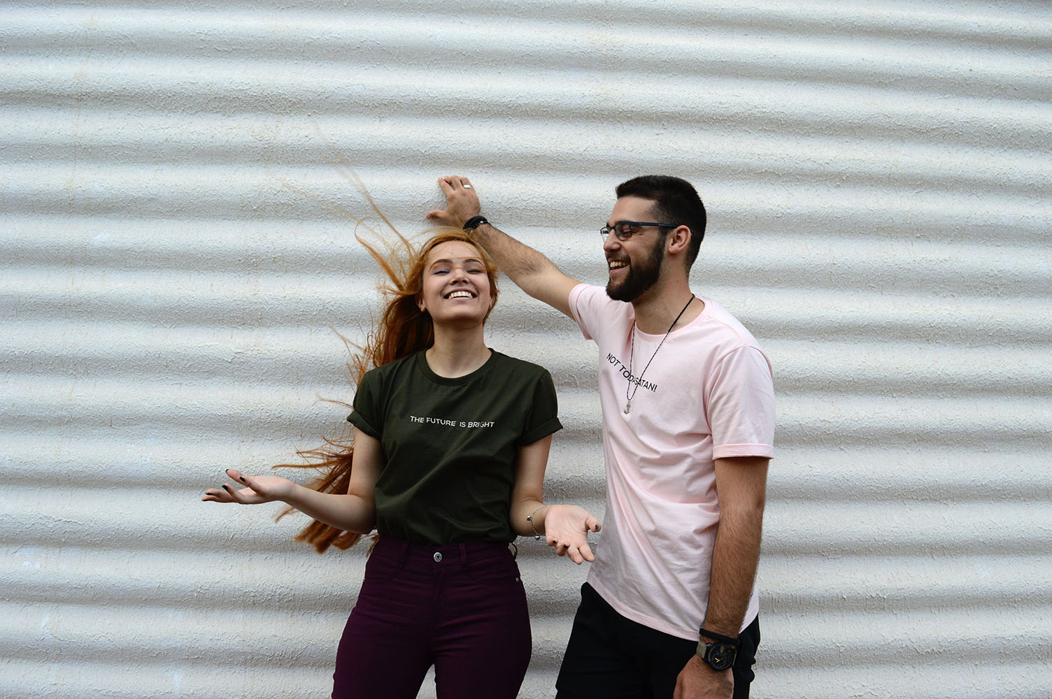
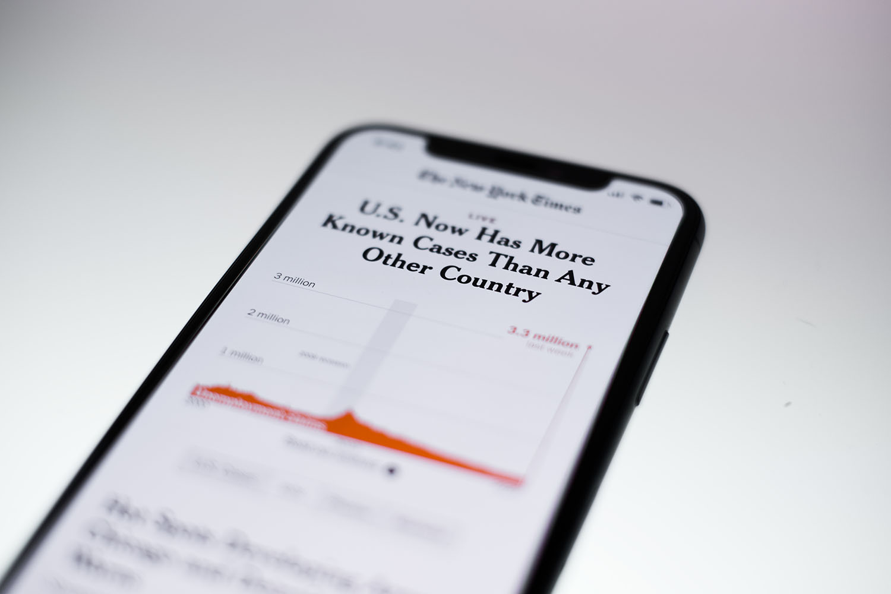
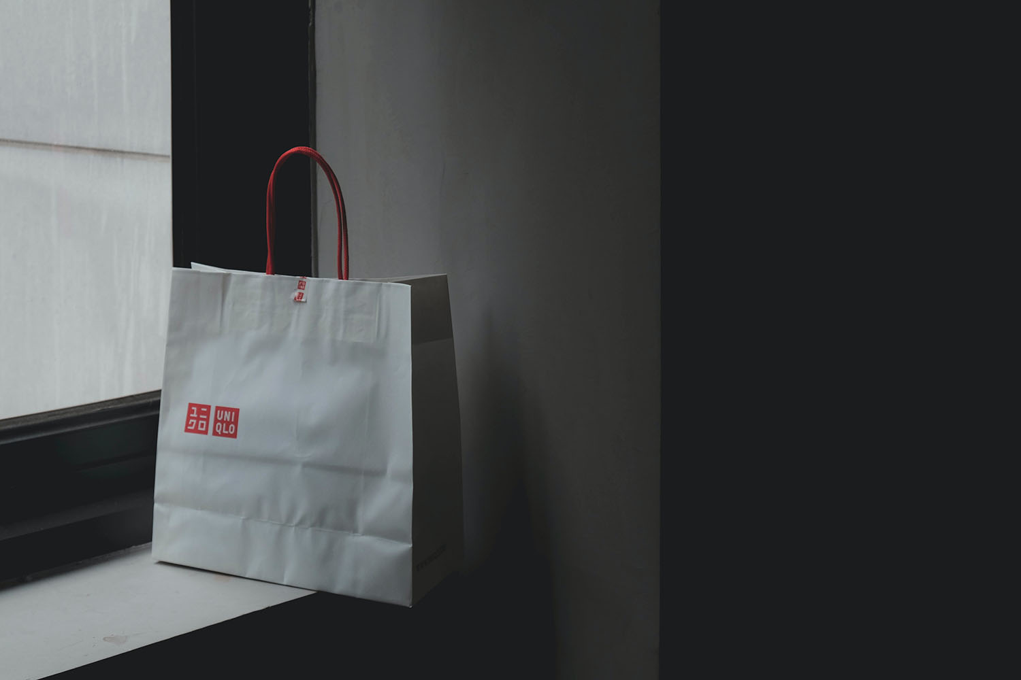
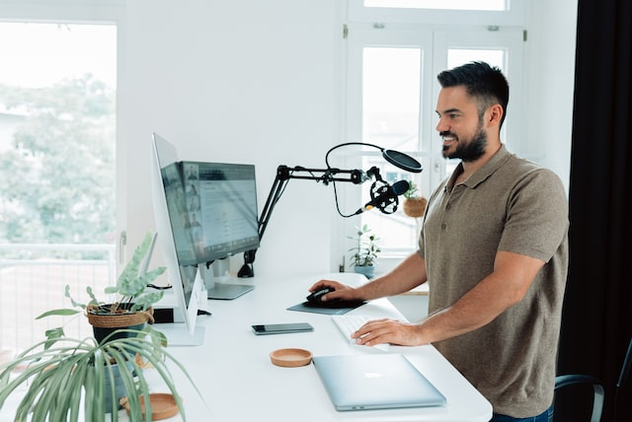
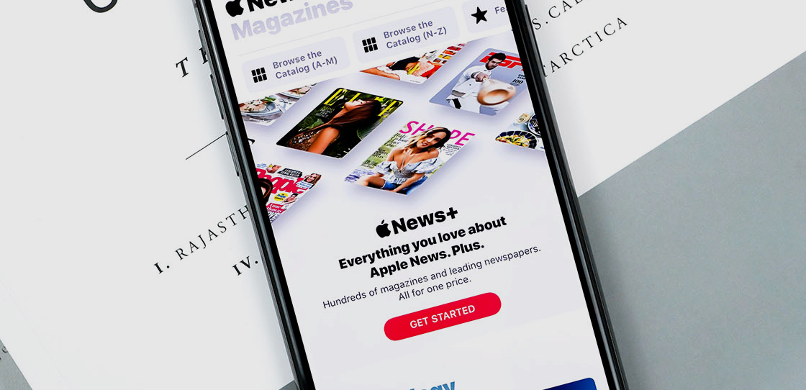
CAMPAIGN HIGHLIGHTS
Campaign:
Campaign:
Campaign:
Limited edition launch
Micro celeb endorsement
Senior appointment news
Date:
Date:
Date:
Jan 15 – Feb 1
Mar 1 - Ongoing
As needed
Media channels:
Media channels:
Media channels:
Affiliate program
Website, social channels, email marketing
Digital PR, social mentions

Slide 19
PRESS RELEASE PERFORMANCE
FIRST 7-DAY REACH ON THE RISE
PRESS RELEASE | DATE | IMPRESSIONS | READS | INTERACTIONS
New CEO Announcement | Jan 20
EMEA Expansion | Jan 30
Regulatory Announcement | April 10
Q2 Earnings | July 15
Product Announcement | Aug 20

Slide 20
PR CONTENT MAP
MAJORITY OF IMPRESSIONS OCCUR IN FIRST 7 DAYS
ENGAGEMENT METRICS
Jan 30
Feb 10
April 15
July 15
Oct 6
Jan 30
Feb 10
April 15
July 15
Oct 6
10K
5K
0K
MEDIA DELIVERIES
800
600
400
200
0
SITE VISITS
All time Impressions
150
100
50
0
SITE CONVERSIONS

Slide 21
DOMAIN AUTHORITY (DA)
The higher the Domain Authority of the publisher, the less positive the journalist’s feedback was likely to be.
Our observations
Feedback from writers working for sites with a DA lower than 89 was most likely to be complimentary of the content campaigns we pitched them.
The verbiage of their responses was also more positive on average than those from journalists working for publishers with a DA of 90 or above.
More positive
Average Sentiment Score
Less positive

Slide 22
MEDIA RELATIONS & PR MATURITY INDEX
MEDIA RELATIONS AND PR DIMENSIONS
LVL
Media Awareness
2.7
Positioning
5.0
Internal Support
4.0
Expertise
3.0
Process
2.2
Media Relationships
1.7
Overall Weighted Average (out of 5)
3.1

Slide 23

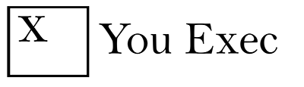
BRAND REPUTATION
MAIN COMPETITORS
2019 Rank
2019 Rank
2019 Rank
2019 Rank
94
42
88
72
20XX Rank
Change in Rank
Change in Rank
Change in Rank
Change in Rank
94
-43
39
29
23
Change in Rank
2019 Rank
2019 Rank
2019 Rank
2019 Rank
22
41
91
97
43
Change in Rank
Change in Rank
Change in Rank
Change in Rank
-18
-13
13
-9

Slide 24
BRAND VALUE RANKING
20XX RANK
BRAND
CHANGE IN BRAND VALUE
BRAND VALUE
01 |  | +9% | $234,241 M
02 |  | +8% | $167,713 M
03 |  | +24% | $125,263 M
04 |  | +17% | $108,847 M
05 |  | -4% | $63,365 M
06 |  | +2% | $61,098 M
07 |  | +5% | $56,246 M
08 |  | +5% | $50,832 M
09 |  | +4% | $45,362 M
10 |  | +11% | $44,352 M

Slide 25
SOCIAL PROOF
LET’S HEAR WHAT OTHERS SAY ABOUT US:
The analytical ability to apply it’s knowledge into real-world scenarios and commitment to excellence makes ABC a great addition any organization.
ABC sits among the industry leaders. It’s an ideal choice since it is among the most inventive leaders in it’s space.
ABC is an excellent partner. Their team went above and beyond their call of duty and the results exceeded our expectations. We have been extremely happy working with ABC and would recommend their services to anyone.
XYZ Computer Services
Smart Business Journal
EFG Consultancy

Slide 26
Online reviews as helpful as friends and family during purchase decision
Shopper perception of marketing sources when making a purchase decision
% who find given source somewhat to extremely helpful
Online reviews are the most helpful source of influence for customers to make a purchase decision

Slide 27
In response to Company XYZ’s latest stance on current events, I am:
I am more likely to make a purchase from Company ZYZ because:
More likely to make a purchase from company XYZ
I respect their right to express their values
Less likely to make a purchase from company XYZ
I agree with their stances and policies
Unaffected, it doesn't matter to me either way
I’ve been a loyal customer
N=1,000 consumers
N=250 who’re more likely to purchase

Slide 28
MEDIA SENTIMENT MONITORING
Social Media Reach
Number of mentions
Number of Positives
Number of Negatives

Slide 29
CRISIS SENTIMENT ANALYSIS
SENTIMENT
NET SENTIMENT OVER TIME
15%
43%
100%
POSITIVE
NEGATIVE
50%
ENGAGEMENT
-50%
651.2K
-100%
21,6%
Compared to the previous period
1 JAN
4 JAN
7 JAN
10 JAN

Slide 30
SENTIMENT DISTRIBUTION
BEFORE
AFTER
Neutral
Positive
Negative
Neutral
Positive
Negative

Slide 31

(1/2) PR CRISIS COMMUNICATION PLAN:
THE FIRST 60-MINUTES
ACTION TO TAKE IN THE GOLDEN HOUR OG A PR CRISIS
1-5 MINUTES
Call emergency services if relevant (law enforcement, medical, fie, rescue)
1-15 MINUTES
Establish the facts
15-30 MINUTES
Draft a holding media statement Brief internal stakeholders, your lawyer, family members, local authorities or anyone else
15-60 MINUTES
Monitor social media and track specific keywords or hashtags that may be associated with your crisis. Also watch in real time results for your own name or your company name

Slide 32
30-45 MINUTES
Do you need to update your draft media statement based on any new information that has come to light? Issue the initial statement. Brief the spokesperson on the facts, the official statement and a timeframe when you will again speak to the media
45-50 MINUTES
Collect some images or footage that might be useful for the media
50-60 MINUTES
Convene a team meeting and agree next steps and who does what
(2/2) PR CRISIS COMMUNICATION PLAN:
THE FIRST 60-MINUTES

Slide 33

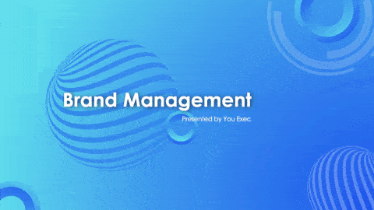


Related
The following resources are related to this framework and can save you hours of work.
If you’re a free or paid member, log into You Exec first for a better download experience.
Marketing Plan
Brand Management
Sustainability Report
Corporate Brand Deck

